Slide 1
Web Development and API Design Lesson 07: RESTful APIs
Prof. Andrea Arcuri

Slide 2
Goals
Revision of URLs and HTTP
Understand the main concepts of REST web services
Introduction on how to build a REST web service using NodeJS
Understand differences and similarities between handling of static resources and dynamic content
e.g., HTML/CSS files vs. JSON data

Slide 3
HTTP

Slide 4
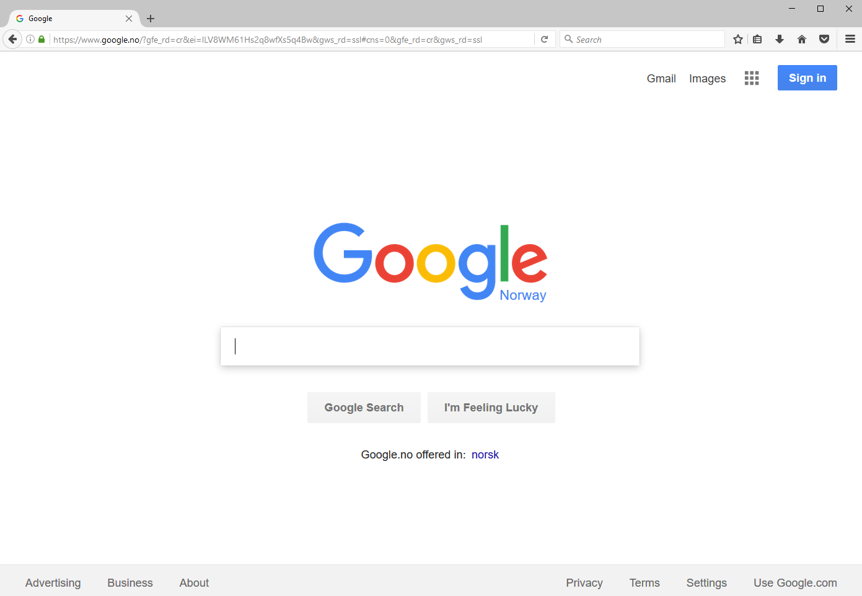

Slide 5
Send a HTTP request over TCP, and get back a HTML page which will be visualized in the browser

Slide 6
URL (Uniform Resource Locator)
Reference to a web resource and how to retrieve it
scheme:[//[user:password@]host[:port]][/]path[?query][#fragment]
https://en.wikipedia.org:443/wiki/Uniform_Resource_Locator#Syntax
scheme
port
fragmet
host
path

Slide 7
Cont.
Scheme: how to access the resource
http, https, file, ftp, etc.
Host: the name of the server, or directly its numeric IP address
Port: the listening port you will connect to on the remote server
Path: identifies the resource, usually in a hierarchical format
Eg, /a/b/c
Query: starting with “?”, list of <key>=<value> properties, separated by “&”
eg https://github.com/search?q=java&type=Repositories&ref=searchresults
Fragment: identifier of further resource, usually inside the main you requested
Eg, a section inside an HTML page

Slide 8
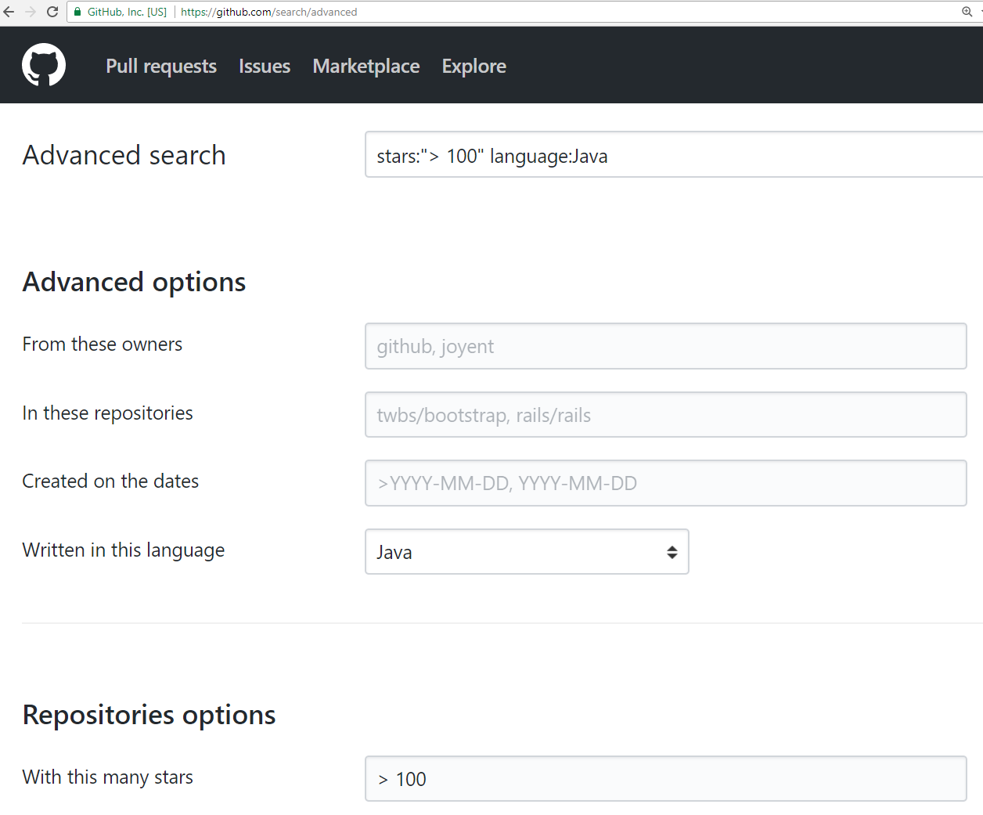
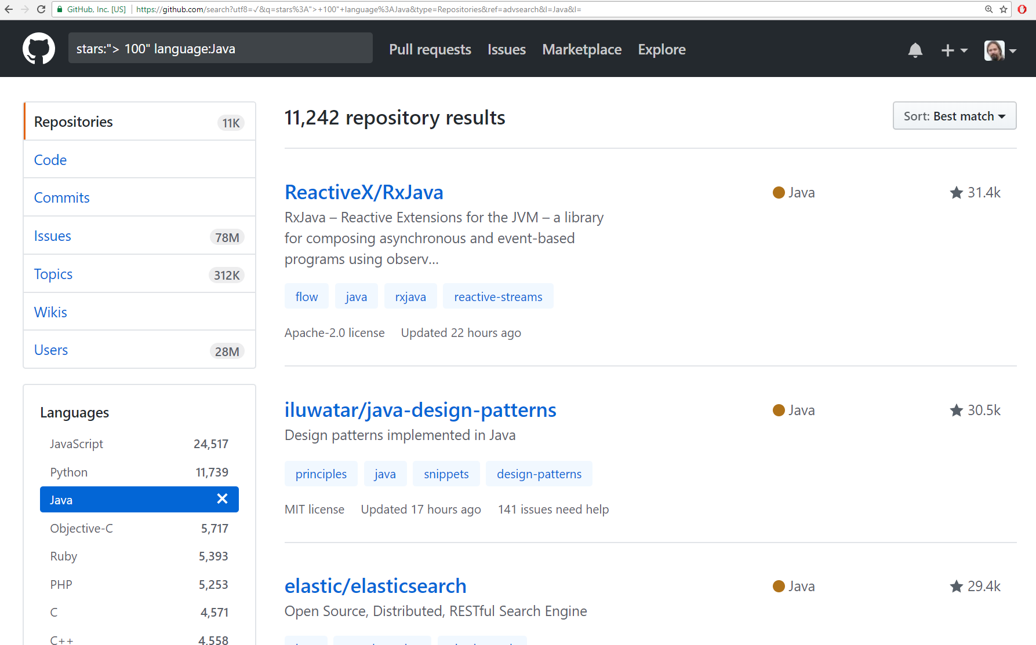
https://github.com/search?utf8=%E2%9C%93&q=stars%3A%22%3E+100%22+language%3AJava&type=Repositories&ref=advsearch&l=Java&l=
The asked page/resource is /search, where it is retrieved in different ways based on the list of query “?” parameters

Slide 9
URI (Uniform Resource Identifier)
String of characters used to identify a resource
A URL is a URI:
Exactly same format
In URL, the resource is typically located on a network
Given a URL, you should be able to access the resource, which is not necessarily true for URI
The distinction between URL and URI is conceptually very thin
Most people use the two terms interchangeably

Slide 10
TCP not Enough
https://en.wikipedia.org:443/wiki/Uniform_Resource_Locator
host:port
Host and port are needed to establish a TCP connection
But what data should we send to specify that we want to retrieve the HTML page at that location?

Slide 11
HTTP History
Protocol Used to specify structure of messages
Started at CERN in 1989
1995: version 0.9
1996: version 1.1
1999: “updates” to 1.1
2014: more “updates” to 1.1
2015: version 2.0

Slide 12
Http Versioning: What a Mess!!!
HTTP is one the worst examples of versioning done wrong
Changing specs and semantics over 18 years, but still keeping the same version number 1.1!!!
Why? To support the largest number of browsers, even very old ones
Not many people realized there was an update in 2014… you might still find quite a few libraries/tools that wrongly use the 1999 version

Slide 13
RFC (Request for Comments)
Technically, a RFC is not a “standard” yet, but it is de-facto in practice
RFC 7230, HTTP/1.1: Message Syntax and Routing
RFC 7231, HTTP/1.1: Semantics and Content
RFC 7232, HTTP/1.1: Conditional Requests
RFC 7233, HTTP/1.1: Range Requests
RFC 7234, HTTP/1.1: Caching
RFC 7235, HTTP/1.1: Authentication
RFC 7540, HTTP/2
Etc.
When working with web services, it is fundamental to understand all the low level details of HTTP

Slide 14
HTTP 1.1 vs 2
v2 is quite recent (2015), and still not so common
Unless otherwise stated, we will just deal with v1.1
From user’s perspective, v2 is like v1.1
Same methods/verbs, just better optimization / performance improvement
More like adding functionalities, not replacing it
Main visible difference: v1.1 is “text” based, whereas v2 has its own byte format (less space, but more difficult to read/parse for humans)

Slide 15
HTTP Messages: 3 Main Parts
First line specifying the action you want to do, eg GET a specific resource
Set of headers to provide extra meta-info
eg in which format you want the response: JSON? Plain Text? XML?
In which language? Norwegian? English?
(Optional) Body: can be anything.
Request: usually to provide user data, eg, login/password in a submitted form
Response: the actual resource that is retrieved, eg a HTML page

Slide 16
First line
<METOD> <RESOURCE> <PROTOCOL> \r\n
Ex.: GET / HTTP/1.1
<method> GET
<resource> /
<protocol> HTTP/1.1
A resource can be anything
html, jpeg, json, xml, pdf, etc.
A resource is identified by its path
Recall URI, and such path is same as file-system on Mac/Linux, where “/” is the root

Slide 17
Different kinds of Methods
GET: to retrieve a resource
POST: to send data (in the HTTP body), and/or create a resource
PUT: to replace an existing resource with a new one
PATCH: to do a partial update on an existing resource
DELETE: to delete a resource
HEAD: like a GET, but only return headers, not the resource data
OPTIONS: to check what methods are available on a resource
TRACE: for debugging
CONNECT: tunneling connection through proxy

Slide 18
Method Semantics
Each of the methods has a clear semantics
Eg GET does retrieve a resource, whereas DELETE should delete it
But how the application server does handle them is completely up to it
Eg, an application server could delete a resource when a GET is executed

Slide 19
Verbs should not be in paths
Given a resource “/x.html”
Wrong: GET on “www.foo.org/x.html/delete” to delete “x.html”
Here the resource would be “/x.html/delete”
Also wrong to use query, eg “www.foo.org/x.html?method=delete”
Paths should represent/identify resources, and NOT actions on those

Slide 20
Idempotent Methods
RFC 7231: “A request method is considered idempotent if the intended effect on the server of multiple identical requests with that method is the same as the effect for a single such request...
… if a client sends a … request and the underlying connection is closed before any response is received, then the client can establish a new connection and retry the idempotent request.”

Slide 21


Which methods are idempotent?
GET
POST
DELETE
PUT
PATCH
HEAD

Slide 22
Headers
Extra meta-information, besides Method/Resource
Pairs <key>:<value>
For example:
In which format am I expecting the resource? HTML? JSON?
In which language do I want it?
Who am I? (important for user authentication)
Should the TCP connection be kept alive, or should it be closed after this HTTP request?
Etc.

Slide 23
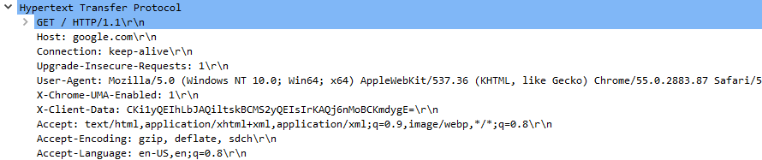
Request for www.google.com in a browser (eg Chrome)
Recall, you can use WireShark or Chrome Developer Tools
Several HTTP headers: eg, including preferred format and language

Slide 24
HTTP Body
After last header, there must be an empty line
Any data after that, if any, would be part of the payload, ie HTTP body
Request: needed for POST, PUT and PATCH
Response: needed for GET (also the other methods “might” have body, but HEAD)

Slide 25

http://www.rd.com/wp-content/uploads/sites/2/2016/04/01-cat-wants-to-tell-you-laptop.jpg

Slide 26
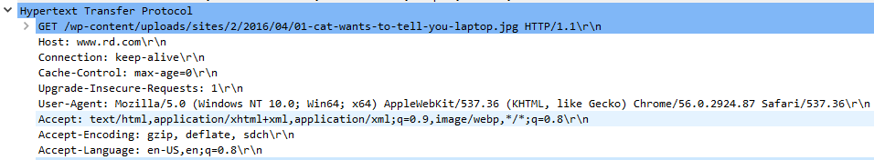
GET with no body
Have a look at the “Accept” header… there is no “jpg” there, why?

Slide 27
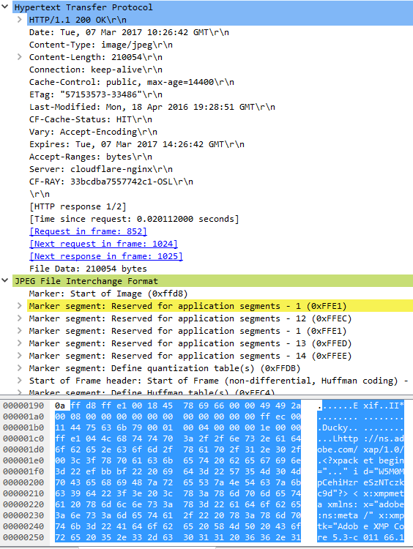
In this case, payload is in JPEG format
“Content-type” header:
need to specify the format, eg JPEG. Note this is necessary because what requested by user (“Accept”) might be a list, and also server might return something different
“Content-length” header:
Essential, otherwise HTTP parser cannot know when payload is finished
Cache handling: headers like “Cache-Control”, “ETag”, “Last-Modified”, etc.
If visiting page for second time, no need to re-download image if hasn’t changed

Slide 28
HTTP Response
Same kind of headers and body as HTTP request
Only first line does differ
<PROTOCOL> <STATUS> <DESCRIPTION>
Eg, “HTTP/1.1 200 OK”
Note: only 1 space “ ” between the tags, I added extras just for readability
When making a request, a lot of things could happen on server, and the “status” is used to say what happened

Slide 29
HTTP Status Codes
3 digit number, divided into “families”
1xx: informational, interim response
2xx: success
3xx: redirection
4xx: user error
5xx: server error

Slide 30
2xx Success
200: OK
201: resource created
202: accepted, but not completed (eg, background operation)
204: no content (eg, as result of PUT or DELETE)

Slide 31
3xx Redirection
Note: the semantics of these codes is a “mess”, being changing with different “updates” of HTTP 1.1… and being left in an inconsistent state
301 permanent redirection
If X redirects to Y, then client will never ask for X again, and go straight for Y
302 temporary redirection
“May” change verb, eg from POST to GET
307 temporary redirection, but same verb
Eg, a POST stays a POST
“Location” header: URI of where we should redirect

Slide 32
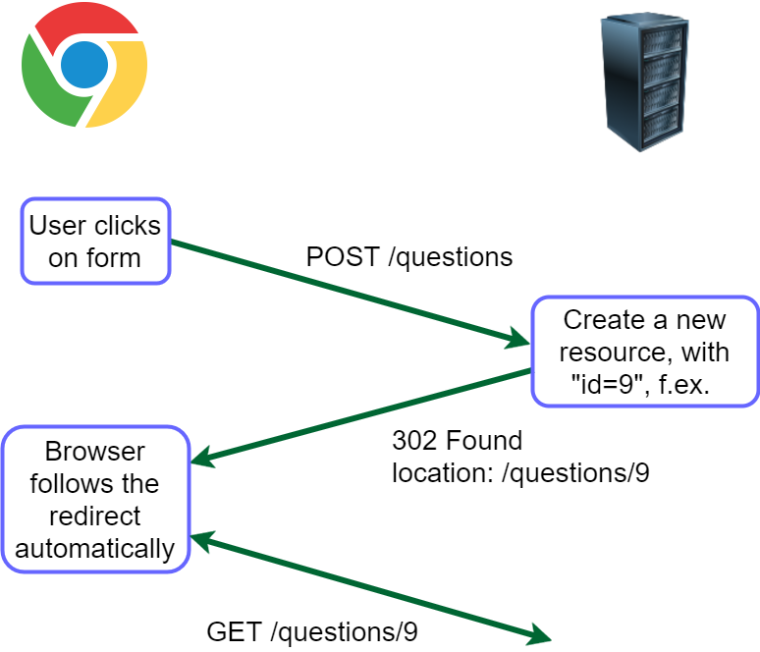

Slide 33
4xx User Error
400: bad request (generic error code)
401: unauthorized (user not authenticated)
403: forbidden (authenticated but lacking authorization, or not accessible regardless of auth)
Note: RFC 7231/7235 are rather ambiguous/confusing when it comes to define authentication/authorization, and differences between 401 and 403
404: not found (likely the most famous HTTP status code)
405: method not allowed (eg doing DELETE on a read-only resource)
415: unsupported media type (eg sending XML to JSON-only server)

Slide 34
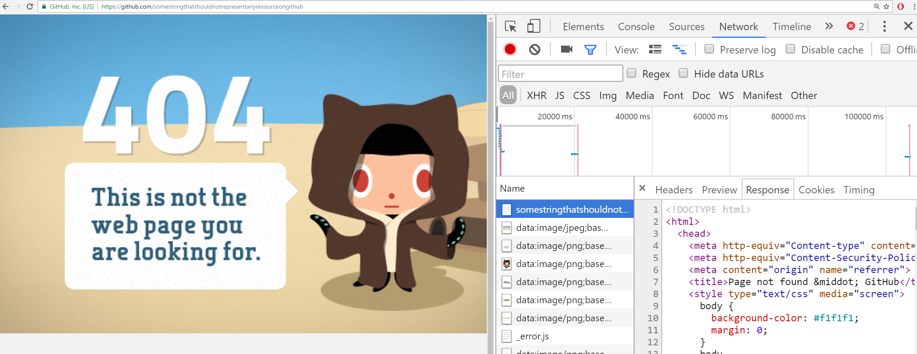
Even if error (eg 404), response can have a body, eg an HTML page to display

Slide 35
5xx Server Error
500: Internal Server Error
Often, a bug, eg an exception in the business logic (like a NPE), that propagates to the application server will be handled with a 500 response
Note: if whole application server does crash, then you get no response…
Required external services have problems, eg database connection failed
503: Service Unavailable
Eg, overloaded of requests, or scheduled downtime for maintenance

Slide 36
HTTPS (HTTP Secure)
Encrypted version of HTTP, using Transport Layer Security (TLS)
Usually on port 443 instead of 80
URIs are the same as in HTTP (just the “scheme” does change)
Note, the whole HTTP messages are encrypted, but still using TCP
this means it is still possible to find out the IP address and port of remote server, although cannot decipher the actual sent messages
this issue can be avoided by going through proxy networks like TOR , or any VPN provider (but this latter would know what you visit)

Slide 37
Web Services

Slide 38
Data/Operations Over Network
Provide APIs over network
Typically TCP connections
HTTP most common protocol
So, can see a Web Service as a process that opens a TCP port and responds to incoming requests

Slide 39
Types of Web Services
REST
most common nowadays
usually strongly tied to HTTP protocol
not a protocol, but set of architectural guidelines
typically serving data in JSON
SOAP
very common in the past, but disappearing nowadays
actual protocol, usually over HTTP
tied to XML
GraphQL
the new kid

Slide 40
Why?
When you want to provide programmable functionalities to your clients over the network
eg, see public list at http://www.programmableweb.com/
Separation of frontend from backend
JavaScript doing client-side HTML rendering on browser, where backend is just a web service providing data
Microservice Architecture
large systems split into several web services of more manageable size
extremely important for modern enterprise systems

Slide 41
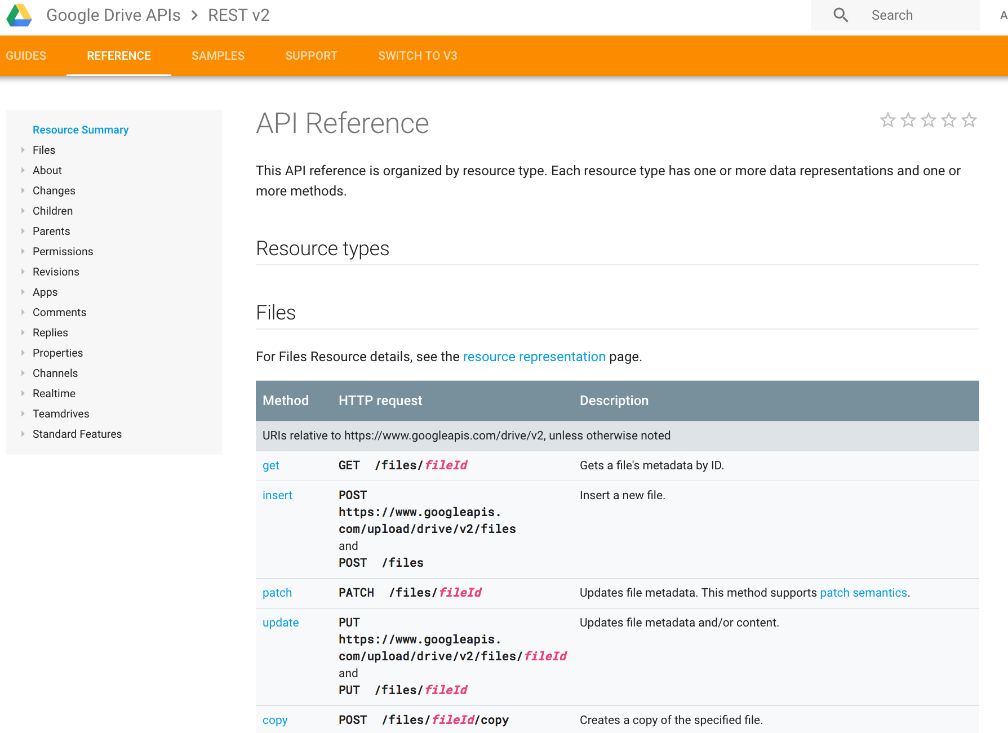

Slide 42
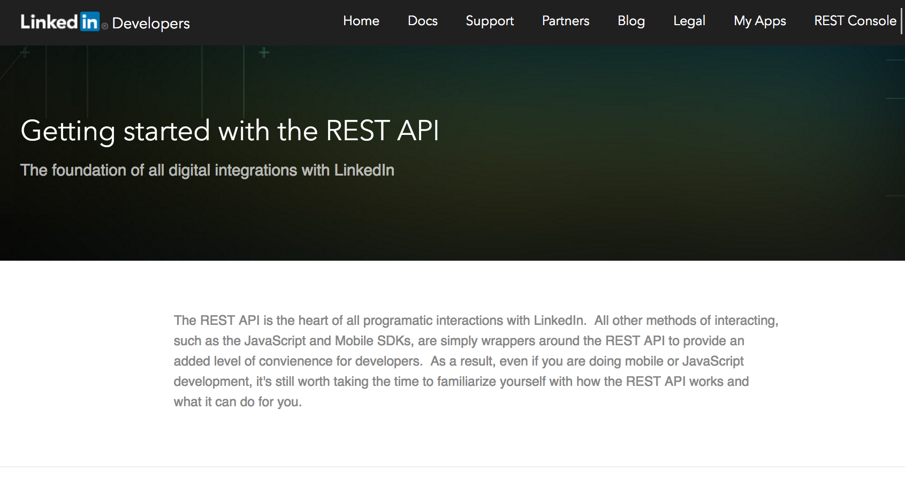

Slide 43
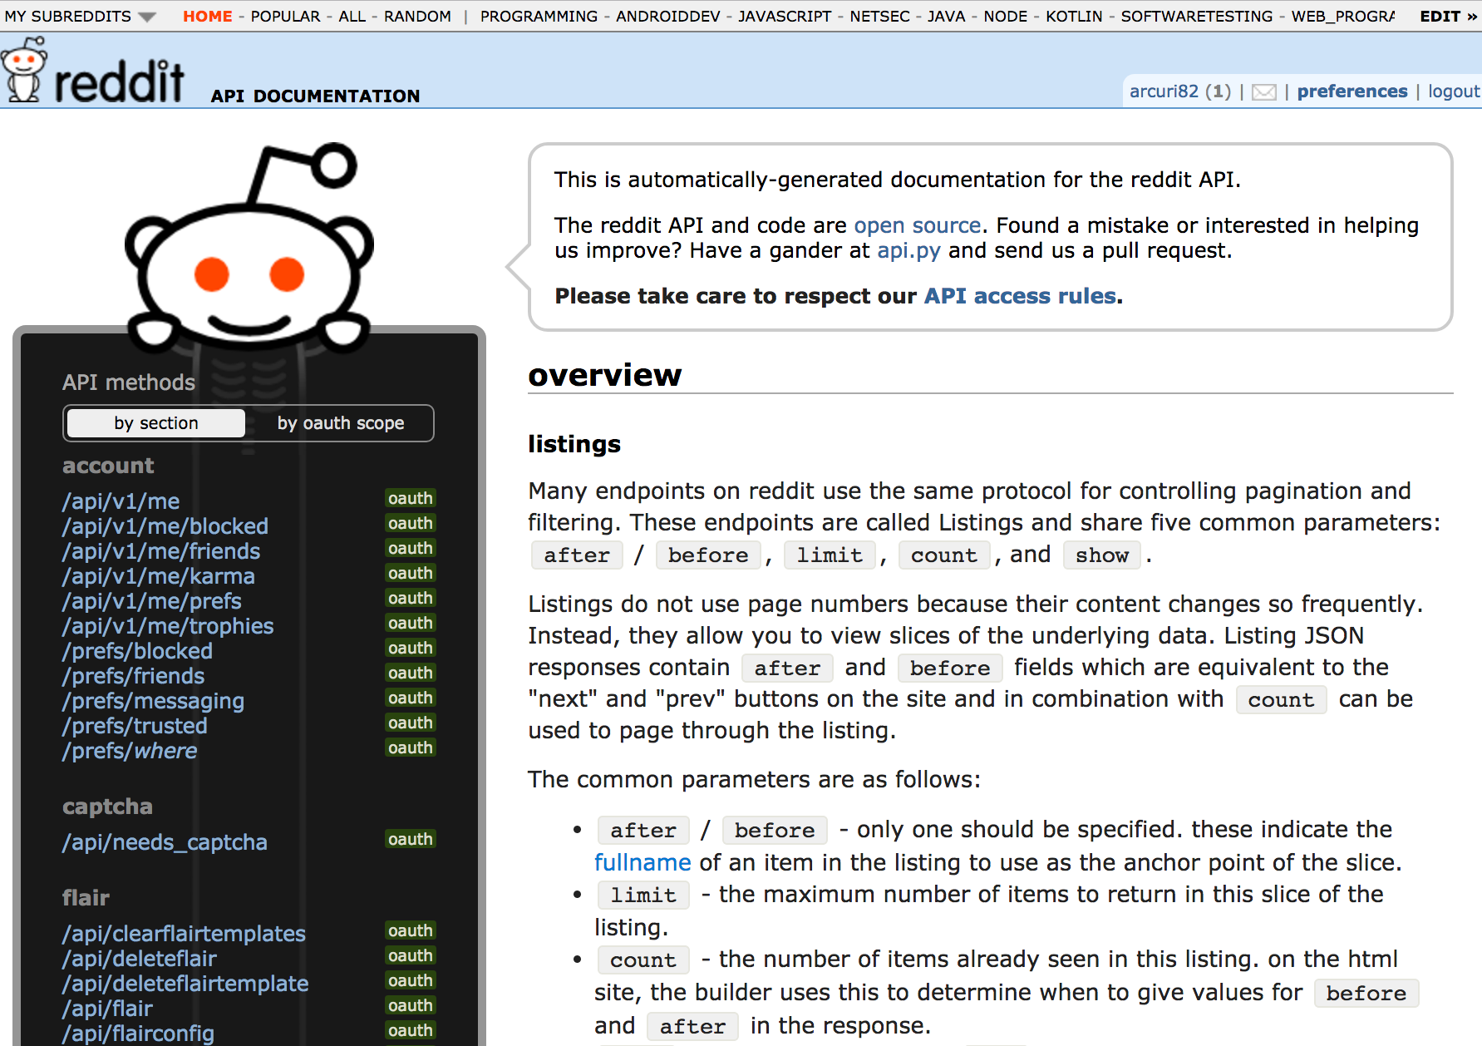

Slide 44
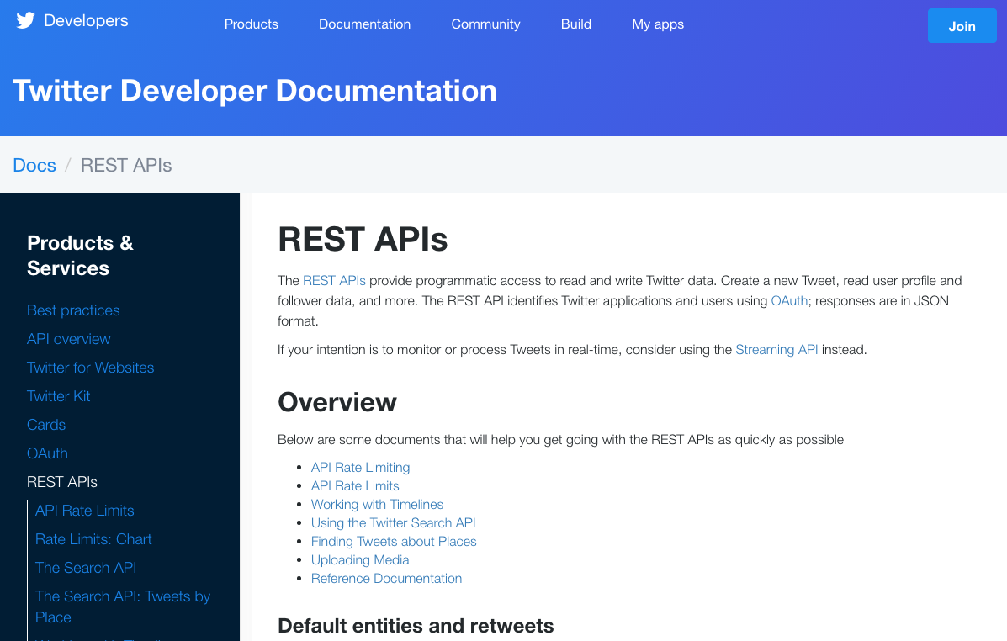

Slide 45
RESTful APIs

Slide 46
RESTful APIs
Representational State Transfer (REST)
Most common type of web services
Access to set of resources using HTTP
REST is not a protocol, but just architectural guidelines on how to define HTTP endpoints
Example: should not delete a resource when answering a GET, but no one will stop you from implementing an API that does that
Introduced in a PhD thesis in 2000

Slide 47
REST Constraints
Uniform Interface
Stateless
Cacheable
Client-Server
Layered System
Code on demand (optional)

Slide 48
1: Uniform Interface
Resource-based, identified by a URI
The actual resource could be anything
e.g., rows in a SQL database, or image files on disk
Client sees a representation of the resource, and the same resource can be given in different formats
eg, XML, JSON and TXT
Hypermedia as the Engine of Application State (HATEOAS)
Resources connected by links… but hardly anyone uses it…

Slide 49
2: Stateless
Resources could be stored in databases or files
But the web service itself should be stateless
This means that all info to process a request should come with the request itself
eg, as HTTP headers
Consequence examples:
can restart process of web service at any time
horizontal scalability: can have 2 more instances of same service, does not matter which one is answering and in which order

Slide 50
3: Cacheable
Cacheable: avoid making a request if previous retrieved data is still valid
Very important for scalability
Resources should define if they are cacheable or not, and how

Slide 51
4: Client–Server
Clear cut between clients and servers
Client only sees the URIs and the representation (eg JSON), but no internal details of server
eg does not even know if resource is stored in a database or on file
Server does not know how data used on clients
Consequence: clients and servers can be developed/updated independently, as long as URIs/representation are the same

Slide 52
5: Layered System
For clients, should not matter if there is any intermediary on the way to the server
Typical example: reversed proxy
eg, used for load balancing and access policy enforcement

Slide 53
6: Code on Demand (optional)
Servers can temporarily extend or customize the functionality of a client by transferring executable code
eg, transfer JavaScript code
Among the constraints that define REST, this is optional

Slide 54
The Term “REST”
Most APIs out there are called REST by their developers…
… but “technically”, they aren’t
For example, nearly no one uses HATEOAS
So, nowadays, REST loosely means: “A web API where resources are hierarchically structured with URIs, and operations follow the semantics of the HTTP verbs/methods”

Slide 55
Example for a Product Catalog
Full URLs, eg www.foo.com/products
GET /products
(return all available products)
GET /products?k=v
(return all available products filtered by some custom parameters)
POST /products
(create a new product)
GET /products/{id}
(return the product with the given id)
GET /products/{id}/price
(return the price of a specific product with a given id)
DELETE /products/{id}
(delete the product with the given id)

Slide 56
Resource Hierarchy
Consider the resource: /users/3457/items/42/description
/users: resource representing a set of users
/3457: a specific user with that given id among the set of users /users
/items: a set of items belonging to the user 3457
/42: a specific item with id 42 that the user 3457 owns
/description: among the different properties/fields of item 42, just consider its description

Slide 57
Cont.
GET /users/3457/items/42/description
It means: retrieve the description of item with id 42, which belongs to the user with id 3456
But what about GET /items/42/description ???
“Technically”, they would be 2 different resources, because there are two different URIs
But in practice, they are the same

Slide 58
Backend Representation
/users/3457/items/42/description
Could be two different tables in a SQL database, eg Users and Items
Or could be a single JSON file on disk…
or the REST API just collects such data from two other different web services…
or whatever you fancy…
Point is, for the client this does not matter at all!

Slide 59
Available URIs
1st) GET /users/3457/itemIds
2nd) GET /items/42/description
It means: first retrieve the ids of all items belonging to user 3457. Then, to get description for a specific one of them with id 42, make a second GET
But in the 2nd GET, what if we rather used /users/3457/items/42/description ???

Slide 60
Cont.
1st) GET /users/3457/itemIds
2nd) GET /items/42/description
3rd) GET /users/3457/items/42/description
Whether the 2nd or the 3rd (or both) endpoint is needed depends on how clients will typically interact with the API
do they need to access to items regardless of their user owners?
Point is: you need to implement a handler for each endpoint

Slide 61
Path Elements
/users/3457/items/42/description
How does a client know that /users and /items are collections/sets but not /description ?
“Technically”, each of those tokens are path elements, with no specific semantics
Client has to read the documentation of the API
However, to make things simpler, it is a convention to use plural names for set resources

Slide 62
Resource Filtering
Assume you want to retrieve all users that are in Norway
1st) GET /users/inNorway
Problem is, what if you still want to retrieve single users by id?
2nd) GET /users/{id}
Where {} just represents a variable matching any single path element input
Ambiguity: here /users/inNorway would be matched by both endpoints
ie, inNorway could be treated as a user id

Slide 63
Cont.
1st) GET /users/inNorway
2nd) GET /users/byId/{id}
Here there would be no ambiguity, but…
… what would be the semantics of the intermediate resource /users/byId ???
Paths in the URIs should represent resources, and not actions on them

Slide 64
Cont.
1st) GET /users?country=norway
2nd) GET /users/{id}
When we want to apply a filter to get a subset of a collection, then we use query parameters
recall URIs: start with “?”, followed by pairs <key>=<value>
Extra benefit: we can later add extra filter options (e.g., ageMin=18), without altering the routing of requests to the endpoint /users

Slide 65
Resource Creation
POST /users
POST operation on a collection
Payload used to create new element added to the collection
Response will have Location HTTP header telling where to find the newly created resource, eg Location:/users/42
PUT /users/42
PUT operation directly on the URI of the new resource
Need to specify id

Slide 66
Cont.
Which one to use? POST or PUT?
When id is chosen by server (eg linked to an id from SQL database), you need POST
If you use PUT, client must choose the id, and it must be unique
otherwise, you would just overwrite an existing resource

Slide 67
PUT vs POST
1st) GET /users/42 => Response 404
2nd) PUT /users/42
This would make no sense, because:
Not going to do hundreds of GETs until find one with 404 Not Found
Two HTTP requests in sequence are not necessarily atomic, eg, before PUT is executed, someone else could have create the resource, and you would just then overwrite it

Slide 68
Cont.
1st) POST /users => Location: /users/42
2nd) PUT /users/42/address
Assume you create a new user with a POST operation, but without an address
You could then want to create the address resource directly by using a PUT
point is that the resource does not have an id in itself, but rather the id is in a path element ancestor
However, most of the time you would not expose each single field of an object as its own URI endpoint, but rather do a PATCH
eg, PATCH /users/42

Slide 69
Resource Representation
1st) GET /users/42
2nd) GET /users/42.json
3rd) GET /users/42.xml
For what you know, the REST service could store users in a SQL database or a CSV file
What you get is a representation of a resource, which can be in different formats, based on client’s needs
But what’s the problem here?

Slide 70
Cont.
1st) GET /users/42
2nd) GET /users/42.json
3rd) GET /users/42.xml
Because the URIs are different, they are technically 3 different resources
whether they map to the same entity on the backend is another story…
A URI has no concept of type: adding a “.json” extension does NOT change the semantics

Slide 71
Cont.
GET /users/42
You should avoid type extensions on your resources
although you might see many APIs doing it…
Choosing among different types should be based on HTTP headers like Accept
eg, “Accept: application/json”
If a client asks for a specific representation (eg XML), that does not mean that the server would support it
If Accept missing, or generic */*, server would just use the default representation (e.g., JSON)

Slide 72
Static and Dynamic Resources

Slide 73
Static Resources
HTML files
usually just a single index.html is SPAs
CSS
JavaScript source files
eg, bundle.js
Images, documents, or any type of files to download
eg, PDFs
etc.

Slide 74
Dynamic Resources
Data that usually change through time
Can depend on user interactions
create an account, add items to a shopping cart, etc.
Could have long term storage in SQL and NoSQL databases
In REST, usually we will get a representation of those resource in JSON format
Handling/generation of dynamic resources usually depend on business logic in the so called backend

Slide 75
Static vs Dynamic
“Usually”, the static resources will define the frontend of a web application
HTML/CSS/JS/images/etc.
The backend will be a server providing data via JSON, and long term storage with databases
Backend will be a process with business logic written in some programming language (JS, or Java and C#)
Still, for both static and dynamic resources going to use HTTP

Slide 76


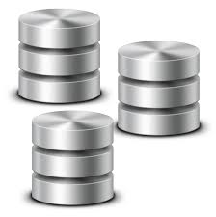
Frontend (e.g., React app) static assets still need to be provided by a HTTP server
Backend (e.g., REST API) with business logic and access to database is still a HTTP server
GET /
GET /style.css
GET /bundle.js
localhost:8080
localhost:8081
GET /api/products
POST /api/products
DELETE /api/products/42

Slide 77
From point of view of the browser, no difference between static assets and JSON responses from a REST API
still going to use HTTP
Frontend and backend can be handled by the same HTTP server
this also avoid issues with CORS (discussed in more details in next class)
GET /
GET /style.css
GET /bundle.js
GET /api/products
POST /api/products
DELETE /api/products/42
localhost:8080

